Slide 1



RETAIL SALES ANALYSIS
in excel

Slide 2
INTRODUCTION
THIS DATASET IS A SNAPSHOT OF A FICTIONAL RETAIL LANDSCAPE, CAPTURING ESSENTIAL ATTRIBUTES THAT DRIVE RETAIL OPERATIONS AND CUSTOMER INTERACTIONS. IT INCLUDES KEY DETAILS SUCH AS TRANSACTION ID, DATE, CUSTOMER ID, GENDER, AGE, PRODUCT CATEGORY, QUANTITY, PRICE PER UNIT, AND TOTAL AMOUNT. THESE ATTRIBUTES ENABLE A MULTIFACETED EXPLORATION OF SALES TRENDS, DEMOGRAPHIC INFLUENCES, AND PURCHASING BEHAVIORS.

Slide 3
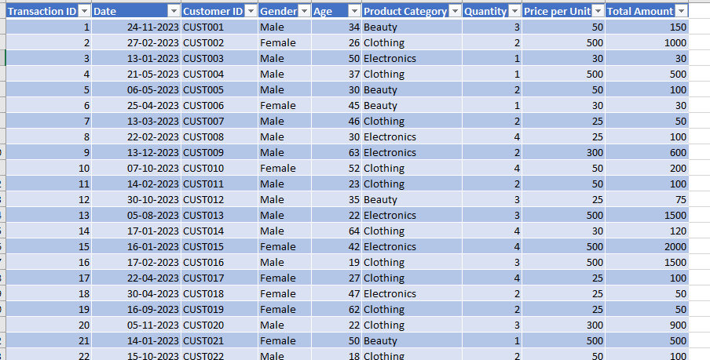
DATASET:

Slide 4
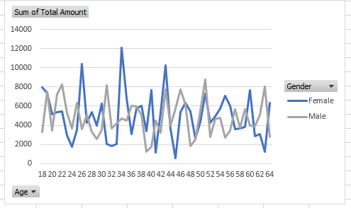
How does customer age and gender influence their purchasing behavior? | How does customer age and gender influence their purchasing behavior? | How does customer age and gender influence their purchasing behavior? | How does customer age and gender influence their purchasing behavior? | How does customer age and gender influence their purchasing behavior? | How does customer age and gender influence their purchasing behavior? | How does customer age and gender influence their purchasing behavior?

Slide 5
INSIGHTS:
FEMALE CUSTOMERS EXHIBIT A HIGHER FREQUENCY OF PURCHASES COMPARED TO THEIR MALE COUNTERPARTS.
WOMEN AGED 26 DEMONSTRATE A HIGHER PURCHASING FREQUENCY COMPARED TO MEN OF THE SAME AGE.
THE AGE GROUP OF 34-36 ALSO SHOWS A HIGHER PURCHASING FREQUENCY AMONG FEMALES COMPARED TO MALES.

Slide 6
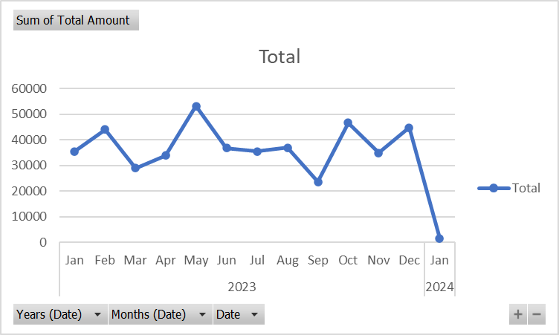
Are there discernible patterns in sales across different time periods? | Are there discernible patterns in sales across different time periods? | Are there discernible patterns in sales across different time periods? | Are there discernible patterns in sales across different time periods? | Are there discernible patterns in sales across different time periods? | Are there discernible patterns in sales across different time periods? | Are there discernible patterns in sales across different time periods?

Slide 7
INSIGHTS:
MAY EXHIBITS THE HIGHEST PEAK IN PURCHASING ACTIVITY.
SEPTEMBER SHOWS A SIGNIFICANT DECLINE IN PURCHASING ACTIVITY.
JANUARY 2024 ALSO EXPERIENCED A NOTABLE DECLINE IN PURCHASING COMPARED TO JANUARY 2023.

Slide 8
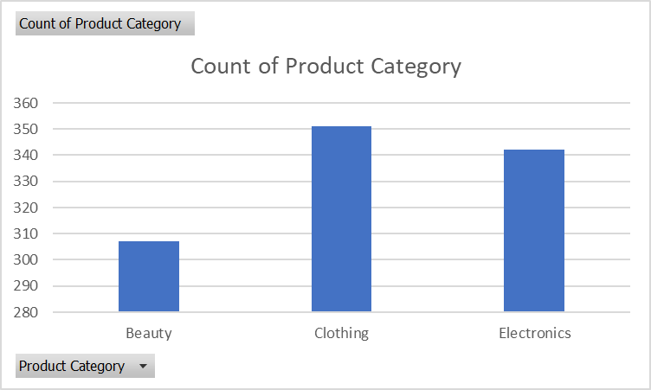
Which product categories hold the highest appeal among customers? | Which product categories hold the highest appeal among customers? | Which product categories hold the highest appeal among customers? | Which product categories hold the highest appeal among customers? | Which product categories hold the highest appeal among customers? | Which product categories hold the highest appeal among customers? | Which product categories hold the highest appeal among customers?

Slide 9
INSIGHTS:
CLOTHING AND ELECTRONICS ARE THE FREQUENT PURCHASES

Slide 10
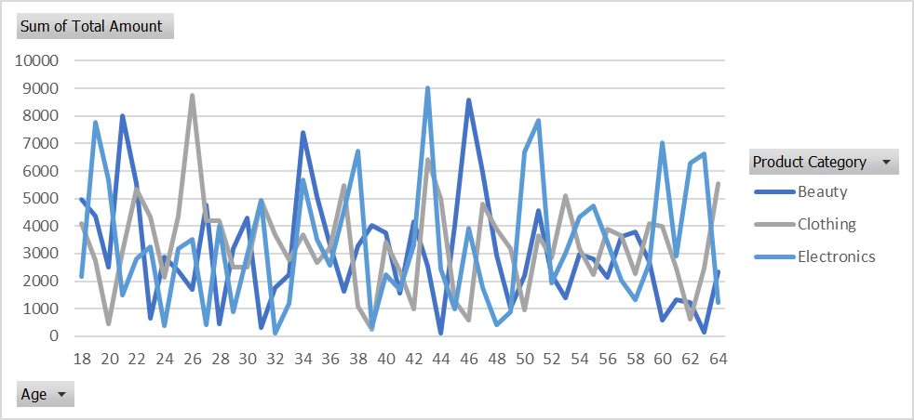
What are the relationships between age, spending, and product preferences? | What are the relationships between age, spending, and product preferences? | What are the relationships between age, spending, and product preferences? | What are the relationships between age, spending, and product preferences? | What are the relationships between age, spending, and product preferences? | What are the relationships between age, spending, and product preferences? | What are the relationships between age, spending, and product preferences? | What are the relationships between age, spending, and product preferences?

Slide 11
INSIGHTS:
CUSTOMERS AGED 20-22 AND 40-42 SHOW SIGNIFICANT PURCHASING ACTIVITY IN BOTH THE CLOTHING AND BEAUTY CATEGORIES.
CUSTOMERS AGED 50 AND ABOVE SHOW MINIMAL OR NO PURCHASES IN THE CLOTHING AND BEAUTY CATEGORIES.
BOTH THE 18-20 AGE GROUP AND CUSTOMERS AGED 55-60 ARE ACTIVELY PURCHASING ELECTRONICS.

Slide 12
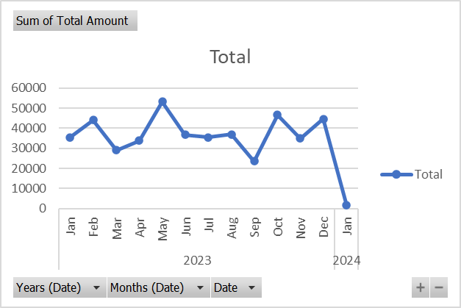
How do customers adapt their shopping habits during seasonal trends? | How do customers adapt their shopping habits during seasonal trends? | How do customers adapt their shopping habits during seasonal trends? | How do customers adapt their shopping habits during seasonal trends? | How do customers adapt their shopping habits during seasonal trends? | How do customers adapt their shopping habits during seasonal trends? | How do customers adapt their shopping habits during seasonal trends?

Slide 13
INSIGHTS:
MAY EXHIBITS THE HIGHEST PEAK IN PURCHASING ACTIVITY.
SEPTEMBER SHOWS A SIGNIFICANT DECLINE IN PURCHASING ACTIVITY.
JANUARY 2024 ALSO EXPERIENCED A NOTABLE DECLINE IN PURCHASING COMPARED TO JANUARY 2023.

Slide 14
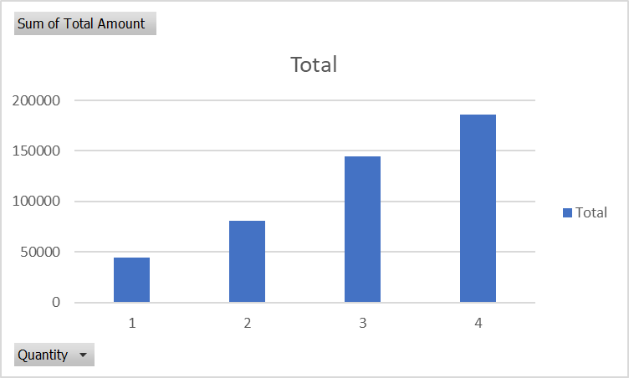
Are there distinct purchasing behaviors based on the number of items bought per transaction? | Are there distinct purchasing behaviors based on the number of items bought per transaction? | Are there distinct purchasing behaviors based on the number of items bought per transaction? | Are there distinct purchasing behaviors based on the number of items bought per transaction? | Are there distinct purchasing behaviors based on the number of items bought per transaction? | Are there distinct purchasing behaviors based on the number of items bought per transaction? | Are there distinct purchasing behaviors based on the number of items bought per transaction? | Are there distinct purchasing behaviors based on the number of items bought per transaction? | Are there distinct purchasing behaviors based on the number of items bought per transaction?

Slide 15
INSIGHTS:
AS THE QUANTITY OF ITEMS PURCHASED IN A TRANSACTION INCREASES, THE TOTAL SALES VALUE TENDS TO RISE. THIS IS DUE TO THE STRAIGHTFORWARD RELATIONSHIP BETWEEN QUANTITY AND TOTAL AMOUNT SPENT.

Slide 16
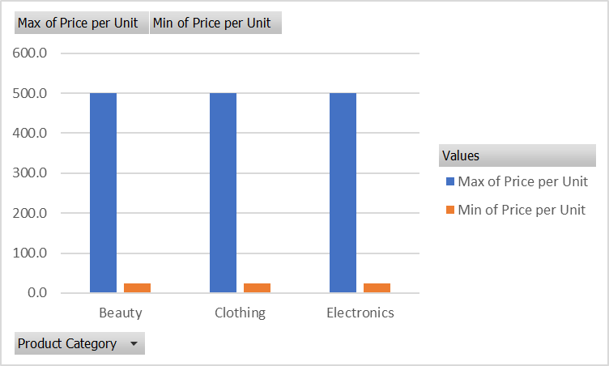
What insights can be gleaned from the distribution of product prices within each category? | What insights can be gleaned from the distribution of product prices within each category? | What insights can be gleaned from the distribution of product prices within each category? | What insights can be gleaned from the distribution of product prices within each category? | What insights can be gleaned from the distribution of product prices within each category? | What insights can be gleaned from the distribution of product prices within each category? | What insights can be gleaned from the distribution of product prices within each category? | What insights can be gleaned from the distribution of product prices within each category? | What insights can be gleaned from the distribution of product prices within each category?

Slide 17
INSIGHTS:
BEAUTY CATEGORY
PRICE RANGE: THE PRICES FOR BEAUTY PRODUCTS RANGE FROM $25 TO $500.
CLOTHING CATEGORY
PRICE RANGE: CLOTHING PRICES VARY FROM $25 TO $500.
ELECTRONICS CATEGORY
PRICE RANGE: PRICES FOR ELECTRONICS SPAN FROM $25 TO $500.

Slide 18
RECOMMENDATIONS
TARGETED MARKETING: FOCUS PROMOTIONS ON KEY DEMOGRAPHICS, SUCH AS WOMEN IN THE 20-22 AND 40-42 AGE BRACKETS FOR CLOTHING AND BEAUTY, AND BOTH YOUNGER AND OLDER ADULTS FOR ELECTRONICS.
SEASONAL PROMOTIONS: DEVELOP TARGETED CAMPAIGNS TO CAPITALIZE ON PEAK PURCHASING PERIODS AND ADDRESS DECLINES DURING SLOWER MONTHS.
BULK BUYING INCENTIVES: IMPLEMENT STRATEGIES TO ENCOURAGE LARGER PURCHASES, SUCH AS VOLUME DISCOUNTS OR BUNDLED OFFERS.
INVENTORY MANAGEMENT: OPTIMIZE INVENTORY LEVELS TO MATCH PURCHASING TRENDS AND AVOID STOCKOUTS OR OVERSTOCK SITUATIONS.
PRICE STRATEGY ADJUSTMENTS: MAINTAIN CONSISTENT PRICING IN BEAUTY FOR AFFORDABILITY, OFFER A WIDE RANGE IN CLOTHING TO SUIT VARIOUS BUDGETS, AND ENSURE ELECTRONICS PRICING REFLECTS THE DIVERSE PRODUCT LINE.

Slide 19





THANK YOU

Slide 20

Project
Proposal
Borcelle Studio

